Slide 1
Data Flow Diagram and Strategy
County New Diagnoses Data

Slide 2
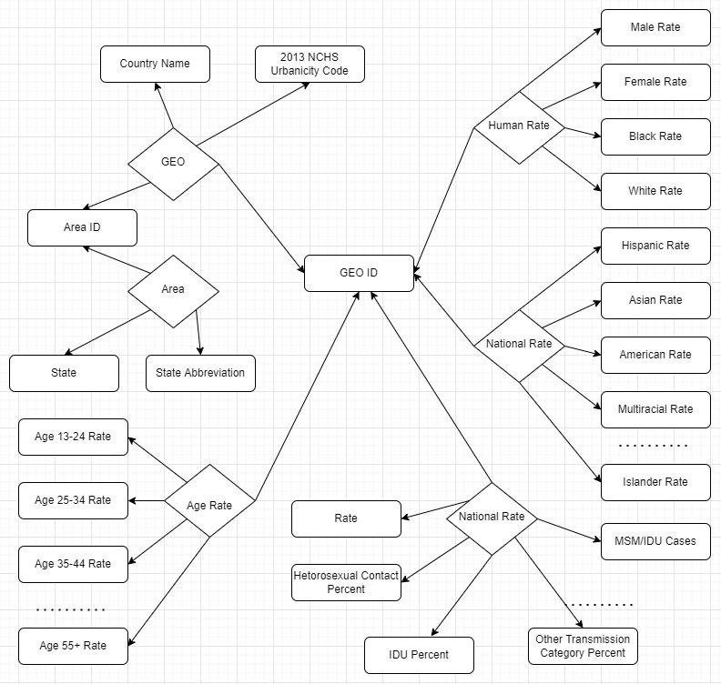
Data Flow Diagram

Slide 3
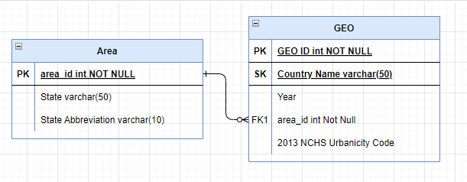
Data Flow Diagram
GEO table and Area table
PK: Primary Key
SK: Secondary Key

Slide 4
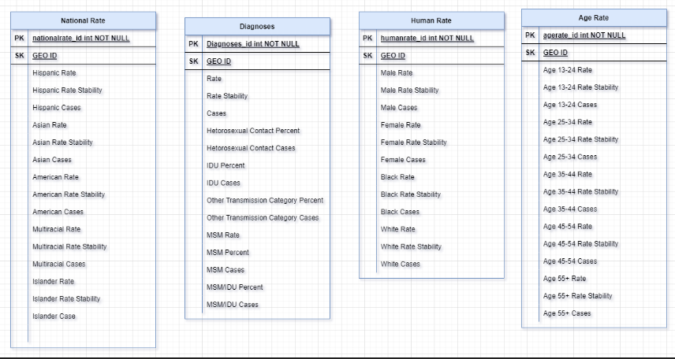
Data Flow Diagram
Diagnoses and National, Human, Age Rate tables
PK: Primary Key
SK: Secondary Key

Slide 5
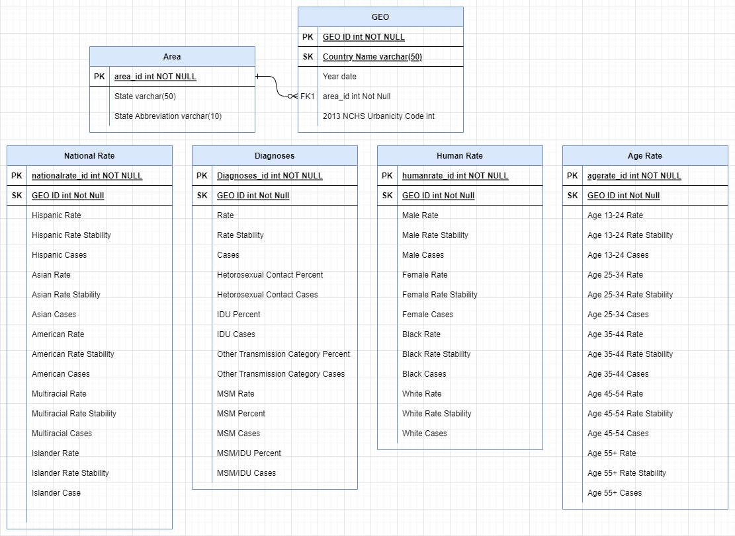
PK: Primary Key
SK: Secondary Key

Slide 6
Data Dictionary
Area Table Data
Field Name | Field Type | Format | Size | Description | Example
ID | int |  | 10
State | varchar |  | 5
State Abbreviation | varchar |  | 20
GEO Table Data
Field Name | Field Type | Format | Size | Description | Example
GEO ID | int |  | 10
Year | date | YY
Country Name | varchar |  | 250
2013 NCHS Urbanicity Code | int
Area ID | int |  | 10

Slide 7
General Rate Table Data
Field Name | Field Type | Format | Size | Description | Example
GEO ID | int |  | 10
New Diagnoses Rate | float |  | 8
New Diagnoses Rate Stability, | float |  | 8
New Diagnoses Cases, | float |  | 8
New Diagnoses Heterosexual Contact Percent, | float |  | 8
New Diagnoses Heterosexual Contact Cases, | float |  | 8
New Diagnoses IDU Percent, | float |  | 8
New Diagnoses IDU Cases, | float |  | 8
New Diagnoses Other Transmission Category Percent, | float |  | 8
New Diagnoses Other Transmission Category Cases, | float |  | 8
New Diagnoses MSM Rate, | float |  | 8
New Diagnoses MSM Percent, | float |  | 8
New Diagnoses MSM Cases, | float |  | 8
New Diagnoses MSM/IDU Percent, | float |  | 8
New Diagnoses MSM/IDU Cases, | float |  | 8

Slide 8
Human Rate Data
Field Name | Field Type | Format | Size | Description | Example
GEO ID | int |  | 10
New Diagnoses Male Rate, | float |  | 8
New Diagnoses Male Rate Stability, | float |  | 8
New Diagnoses Male Cases, | float |  | 8
New Diagnoses Female Rate, | float |  | 8
New Diagnoses Female Rate Stability, | float |  | 8
New Diagnoses Female Cases, | float |  | 8
New Diagnoses Black Rate, | float |  | 8
New Diagnoses Black Rate Stability, | float |  | 8
New Diagnoses Black Cases, | float |  | 8
New Diagnoses White Rate, | float |  | 8
New Diagnoses White Rate Stability, | float |  | 8
New Diagnoses White Cases, | float |  | 8

Slide 9
National Rate Data
Field Name | Field Type | Format | Size | Description | Example
GEO ID | int |  | 10
New Diagnoses Hispanic Rate, | float |  | 8
New Diagnoses Hispanic Rate Stability, | float |  | 8
New Diagnoses Hispanic Cases, | float |  | 8
New Diagnoses Asian Rate, | float |  | 8
New Diagnoses Asian Rate Stability, | float |  | 8
New Diagnoses Asian Cases, | float |  | 8
New Diagnoses American Indian/Alaska Native Rate, | float |  | 8
New Diagnoses American Indian/Alaska Native Rate Stability, | float |  | 8
New Diagnoses American Indian/Alaska Native Cases, | float |  | 8
New Diagnoses Multiracial Rate, | float |  | 8
New Diagnoses Multiracial Rate Stability, | float |  | 8
New Diagnoses Multiracial Cases, | float |  | 8
New Diagnoses Native Hawaiian/Pacific Islander Rate, | float |  | 8
New Diagnoses Native Hawaiian/Pacific Islander Rate Stability, | float |  | 8
New Diagnoses Native Hawaiian/Pacific Islander Cases, | float |  | 8

Slide 10
Age Rate Data
Field Name | Field Type | Format | Size | Description | Example
GEO ID | int |  | 10
New Diagnoses Age 13-24 Rate, | float |  | 8
New Diagnoses Age 13-24 Rate Stability, | float |  | 8
New Diagnoses Age 13-24 Cases, | float |  | 8
New Diagnoses Age 25-34 Rate, | float |  | 8
New Diagnoses Age 25-34 Rate Stability, | float |  | 8
New Diagnoses Age 25-34 Cases, | float |  | 8
New Diagnoses Age 35-44 Rate, | float |  | 8
New Diagnoses Age 35-44 Rate Stability, | float |  | 8
New Diagnoses Age 35-44 Cases, | float |  | 8
New Diagnoses Age 45-54 Rate, | float |  | 8
New Diagnoses Age 45-54 Rate Stability, | float |  | 8
New Diagnoses Age 45-54 Cases, | float |  | 8
New Diagnoses Age 55+ Rate, | float |  | 8
New Diagnoses Age 55+ Rate Stability, | float |  | 8
New Diagnoses Age 55+ Cases, | float |  | 8

Slide 11
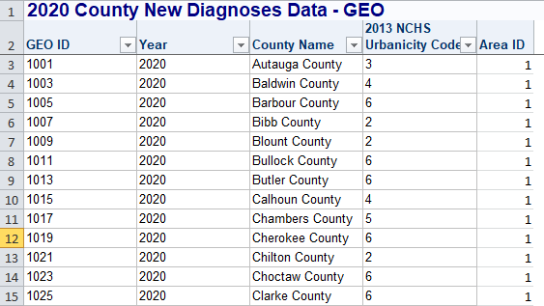
GEO Data tables

Slide 12
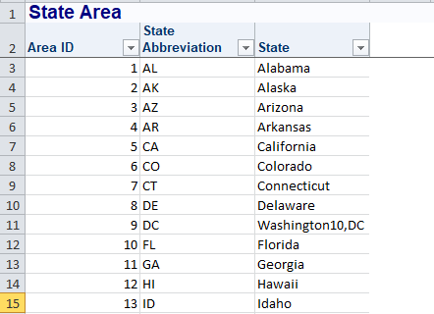
Area Table

Slide 13
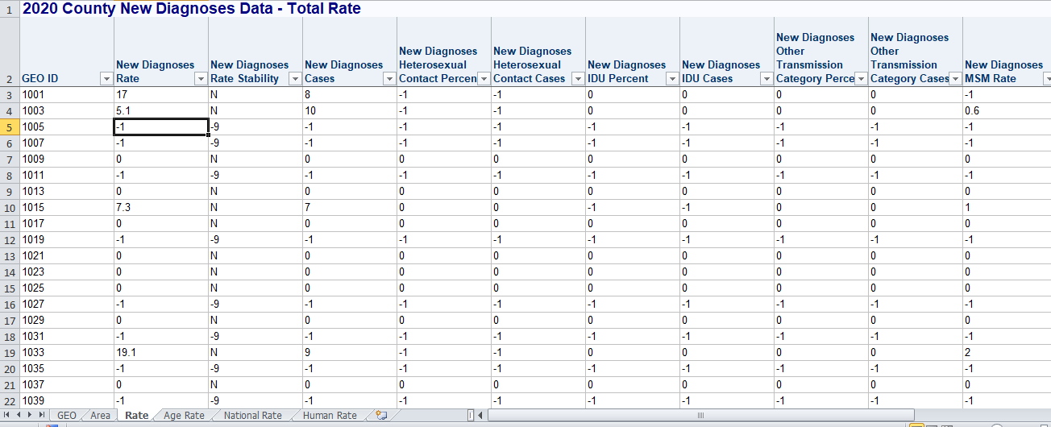
Rate Table

Slide 14
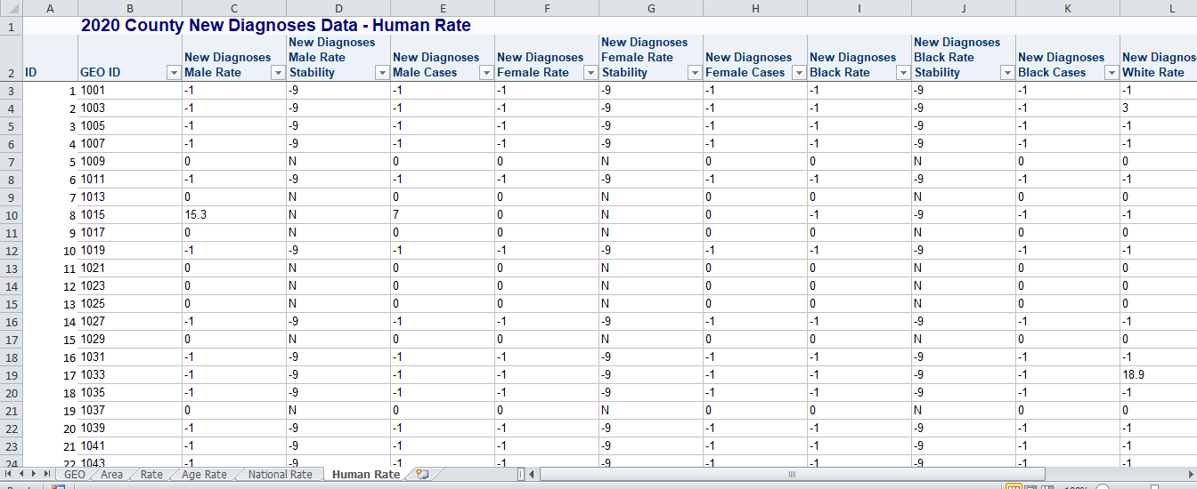
Human Rate Table

Slide 15
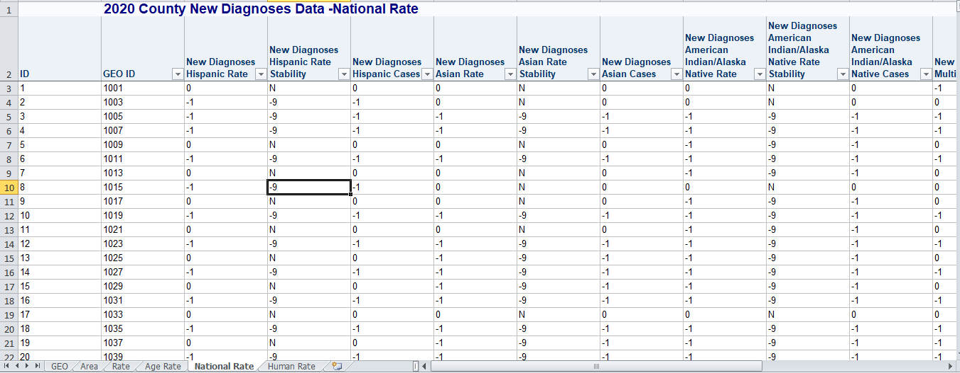
National Rate Table

Slide 16
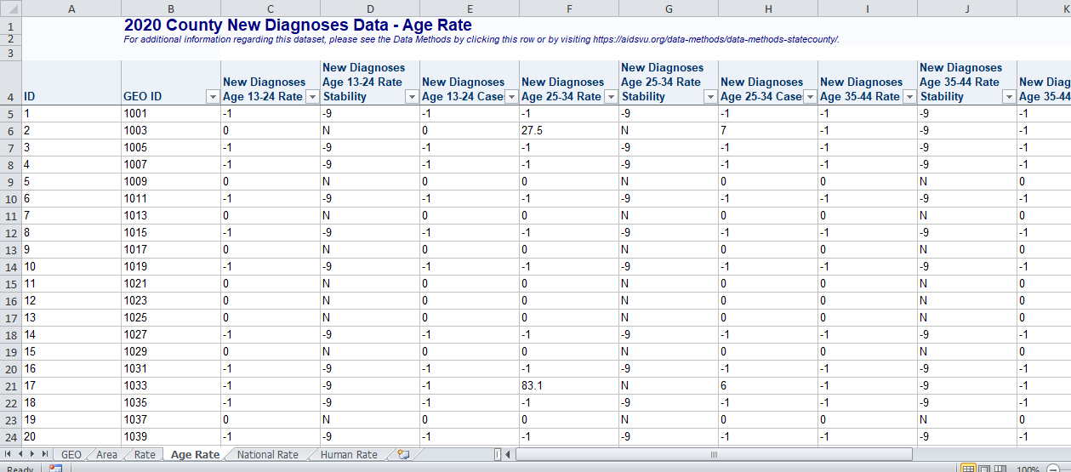
Age Rate Table

